Slide 1
Review Quiz Q0

Slide 2
Review: Logic notation
Not: ¬, ~, !, x̅; And: ∧, &, &&; Or ∨,|,||; If/then implies, →; iff ↔
Precedence: ¬; ∧; ∨; →/↔
De Morgan’s laws: ¬(a ∧ b) ≡ ¬a ∨ ¬b; ¬(a ∨ b) ≡ ¬a ∧ ¬b
Equivalences: a → b ≡ ¬a ∨ b ≡ b ∨ ¬a ≡ ¬b → ¬a
If it does not rain, I commute by bicycle.
When it does not rain, I commute by bicycle.
I commute by bicycle if it does not rain.
I commute by bicycle unless it rains.
Either it rains, or I commute by bicycle.
In English, sometime Or is exclusive (Xor); Math Or is always inclusive.

Slide 3
Review: Quantifiers
∀ = for all = for each s in S = {s₁, s₂, s₃, …}
∀ s in S P(s) is false if we can find any s with P(s) = false. Otherwise it is true.
∀ s in S P(s) ≡ P(s₁) ∧ P(s₂) ∧ P(s₃) ∧ … ≡
True if your worst enemy can’t pick an s that makes P(s) false.
∃ = there exists an = at least one s in S
∃ s in S P(s) is true if we can find any s with P(s) = true. Otherwise it is false.
∃ s in S P(s) ≡ P(s₁) ∨ P(s₂) ∨ P(s₃) ∨ … ≡
True if you can pick an s that makes P(s) true.
Note: ¬∀ s in S ¬P(s) ≡ ∃ s in S P(s) and ¬ ∃ ∀ s in S ¬P(s) ≡ ∀ s in S P(s). DeMorgan’s law for quantifiers
Order matters between different quantifiers: ∃a ∀b vs. ∀b ∃a.

Slide 4
Review: Exponents & logs
For x > 0, log_{b} x = c iff x = b^{c}
b^{c}⋅ b^{d} = b^{c+d} log(xy) = log x + log y
(b^{c})^{d} = b^{cd}= (b^{d})^{c} log(x^{c}) = c log x
a = b^{logb(a)} log_{b}(x) = log_{a}(x) / log_{a}(b)
1/x = x^{─1} log(1/x) = ─log(x)
Special: e = 2.71828…, exp(x) = e^{x} , ln(x) = log_{e}(x), lg(x) = log₂(x)
for all x,y x ≤ y iff exp(x) ≤ exp(y)
for x,y>0 x ≤ y iff log_{b}(x) ≤ log_{b}(y)
Both exp and log are strictly increasing

Slide 5
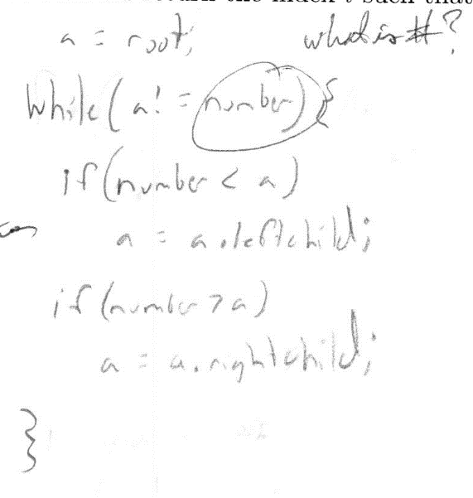
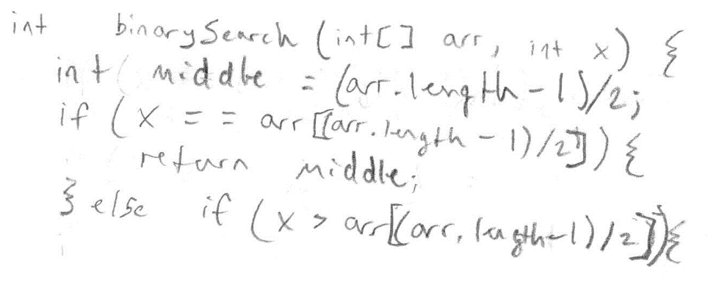
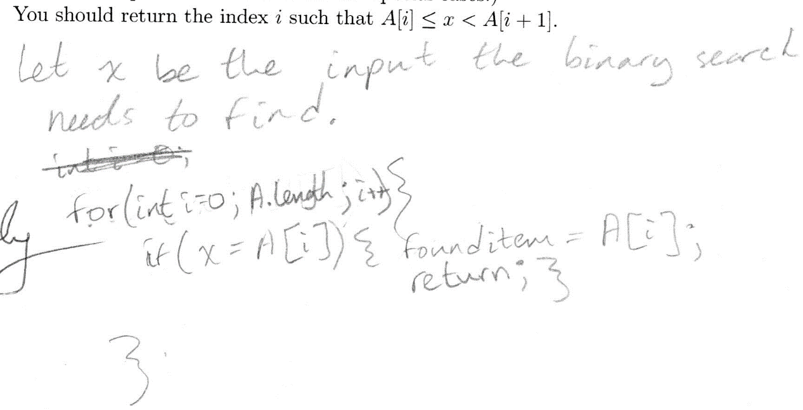
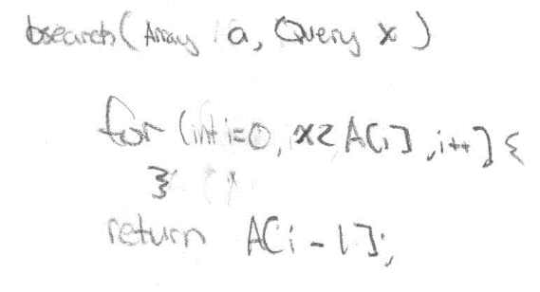
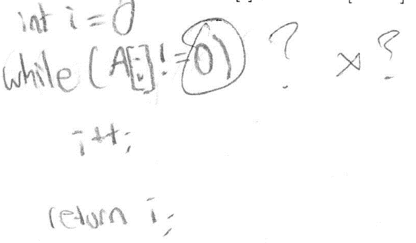
Binary search: Deriving an algorithm from its invariants
COMP 550.002
Jack Snoeyink

Slide 6
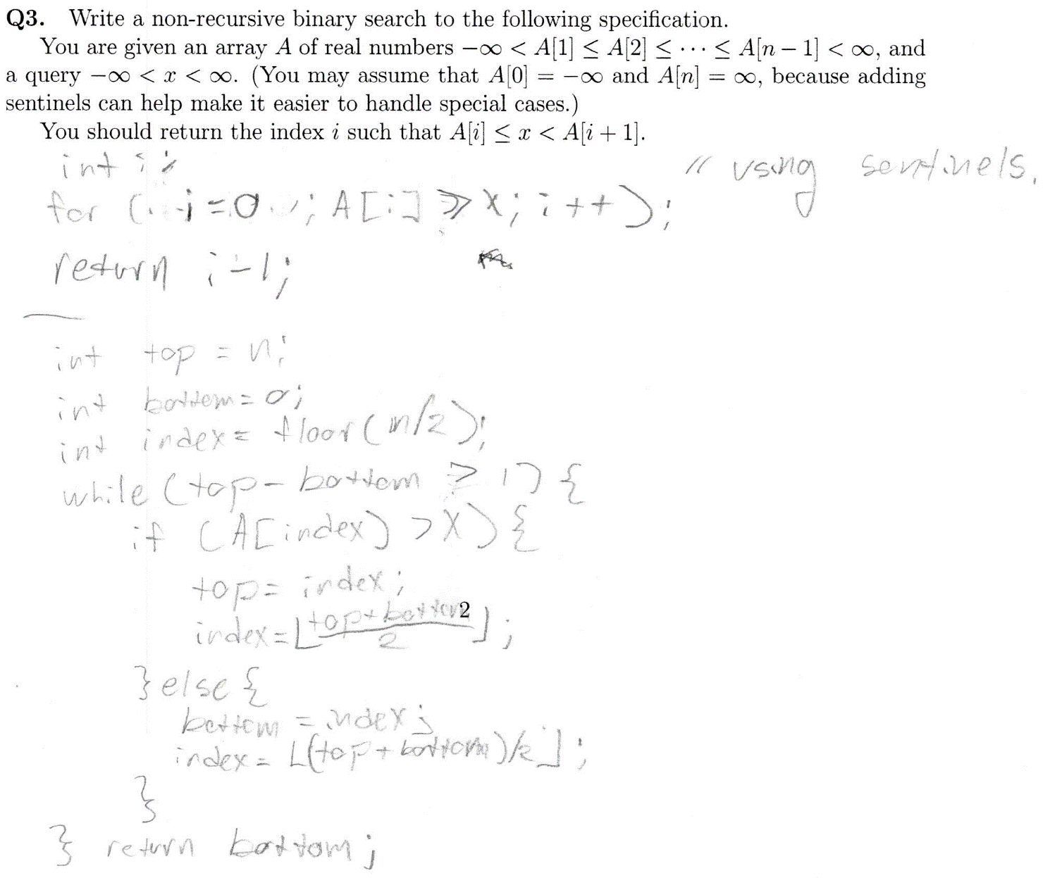
Q3: Binary search
Objectives: From this lecture & slides, you should be able to:
Define and recognize an invariant of an algorithm or procedure.
Derive code for binary search from its invariants.
Pass an interview question about binary search with flying colors.

Slide 7
Q3: From 117 quizzes submitted
1 correct binary search as specified
5 infinite loop (termination)
9 stop too early
21 single index to capture interval
5 linear-time binary search (incl. 2 recursive)
10 some concept of halving
7 correct linear search; 11 incorrect
23 had some text (from 7 “don’t know” to 4 code with no loop)
25 left blank
15 near
51 bin search concept…

Slide 8
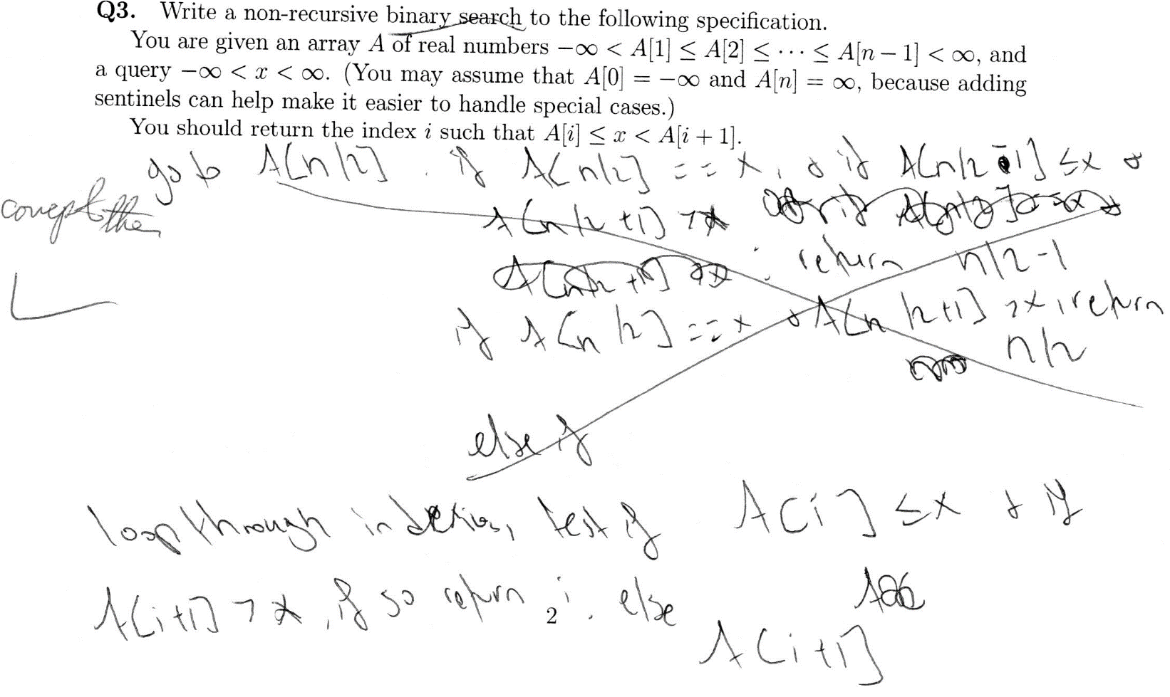
Some memory of binary search concepts, but crossed out
Describes a linear search

Slide 9
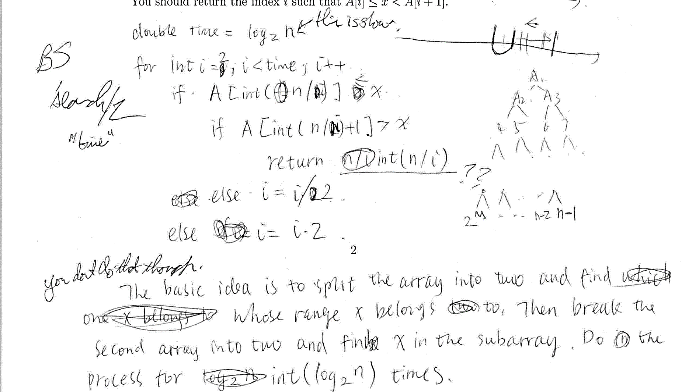
i is time & divisor; not a good idea.
Diagrams can help; here labels A₁, A₂, only confuse…
Tries to track interval with single parameter.
Changes loop index inside loop.

Slide 10
Invariant (Wikipedia)
An invariant “can be relied upon to be true during execution of a program or some portion of it.”
Mental shift: Don’t think about what you tell the computer to do, think about what it will make true.
Invariants are expressed in mathematics, because English is ambiguous.
Not easy: want a small set of invariants, but not too small!
(AI “frame problem:” most statements remain true after an action.)

Slide 11
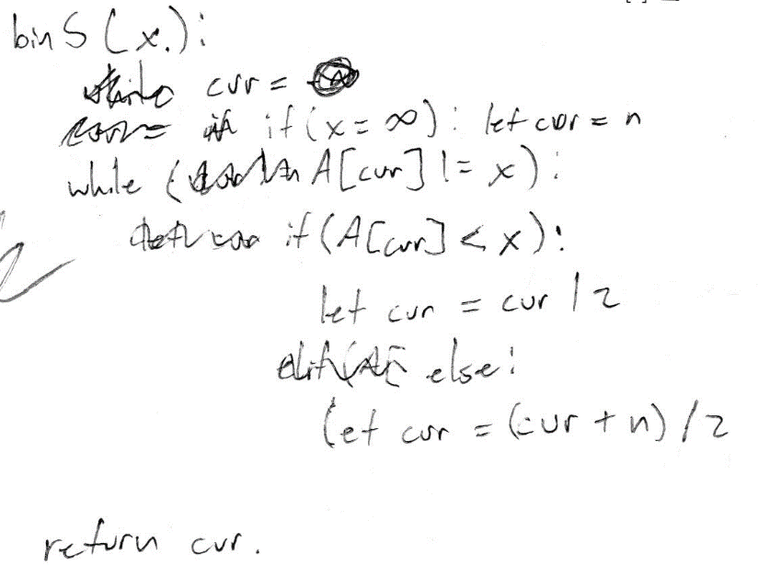
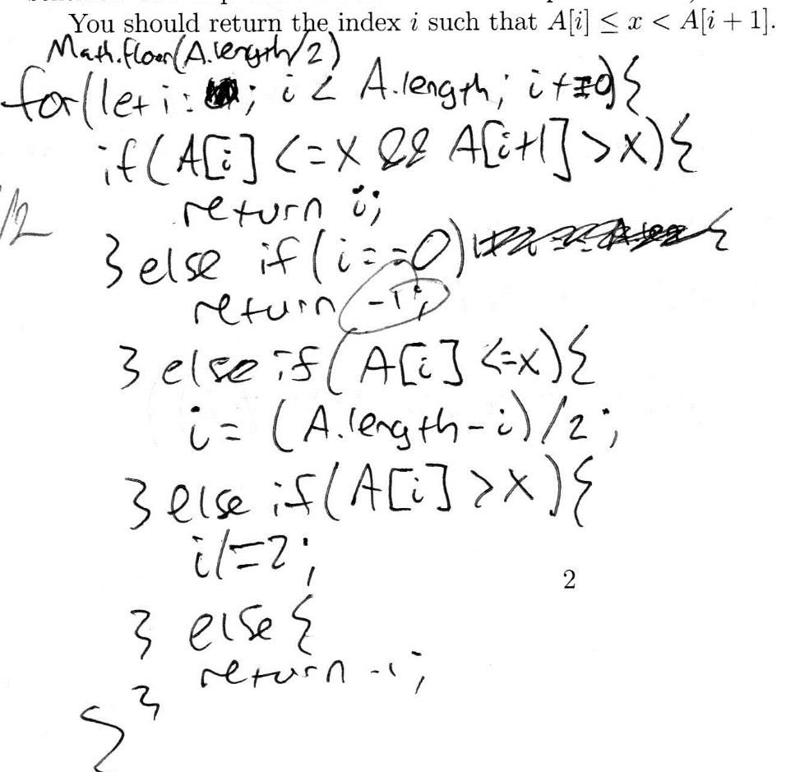
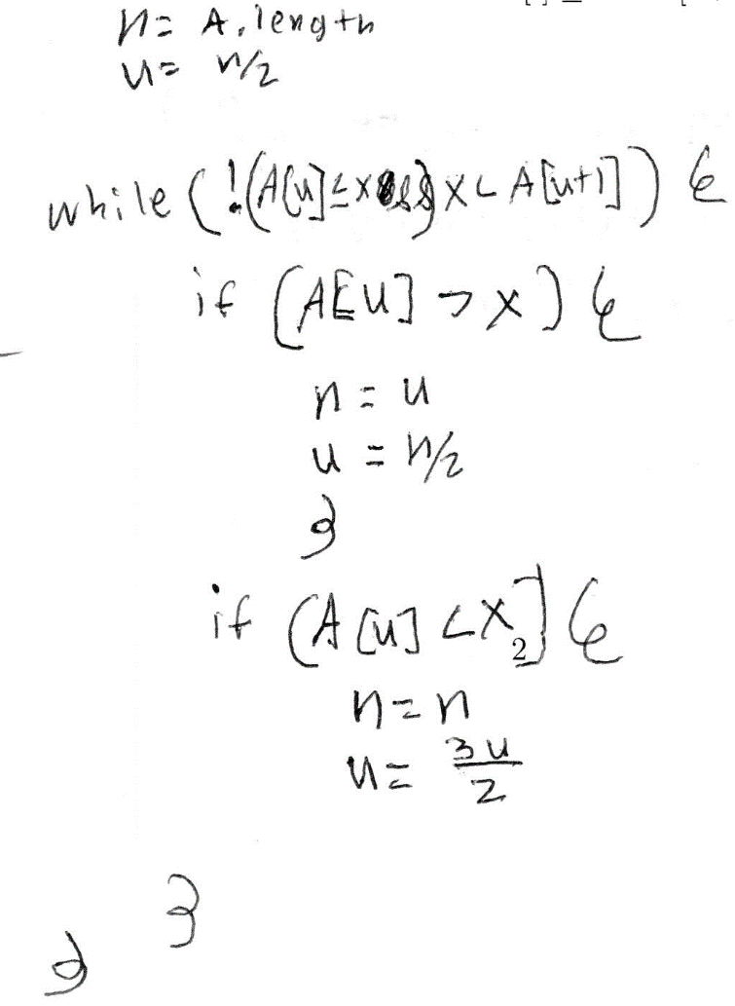
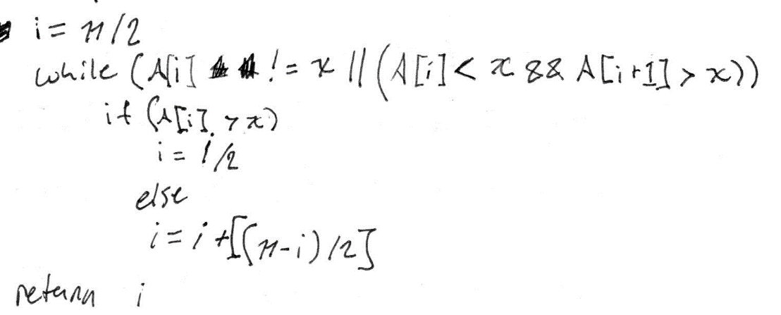
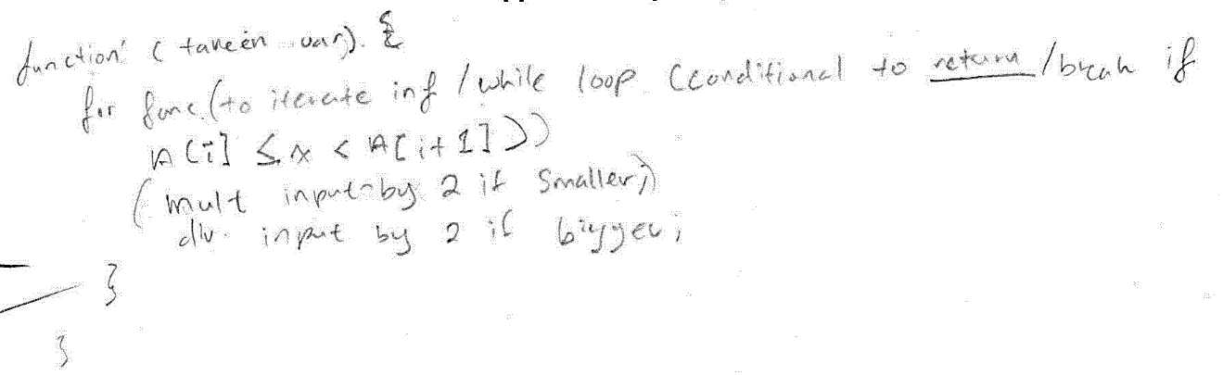
Need interval concept…
None of these work. One also has an infinite loop, one has invalid return values, & one has no return.

Slide 12
Q3: Binary search

Slide 13
Q3: Binary search

Slide 14
Q3: Binary search

Slide 15
Q3: Binary search

Slide 16
Q3: Binary search

Slide 17
Correct!
This one is good! I’d replace the three index lines with this line before “if”:
index = bottom + (top-bottom)/2

Slide 18
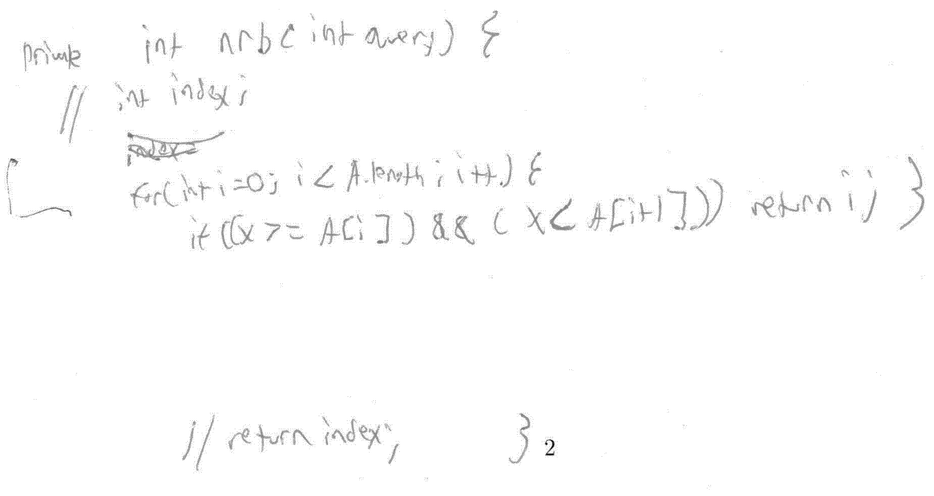
Linear search
OK to implement linear search for testing…
But even this can be improved by thinking of invariants.
I claim we already know (x >= A[i]) when we test it.
We know A[0]<x when we start.
If, at i=k, we know (x >= A[i]), then we test (x<A[k+1]) and return if true.
Thus, when i=k+1, we also already know (x>= A[i]).

Slide 19
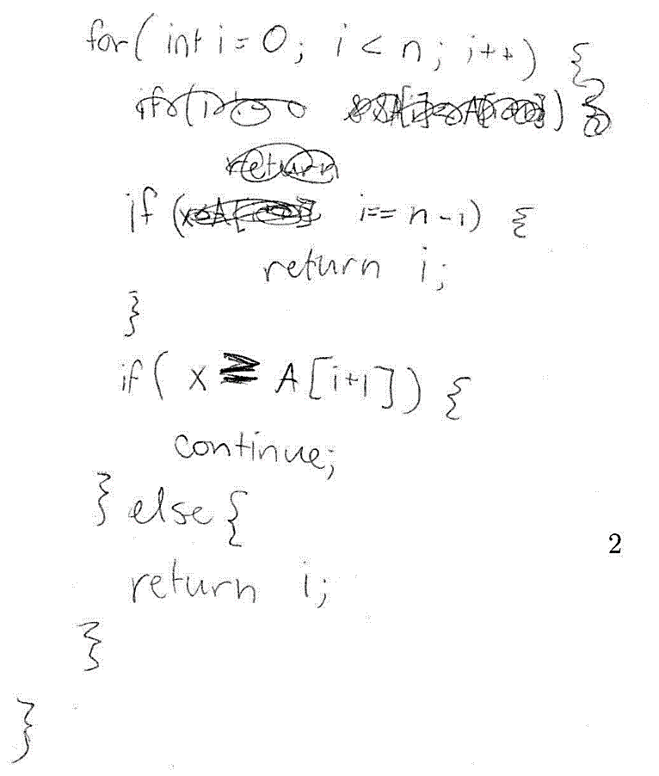
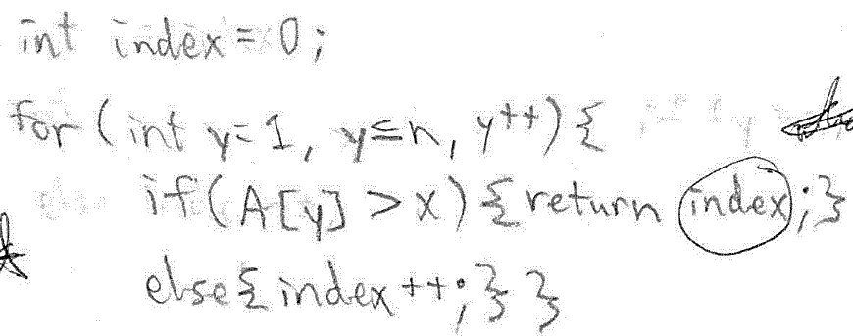
The more lines, the more to debug…
for (int i = 0; i<n; i++)
if (x < A[i+1]) return i;

Slide 20
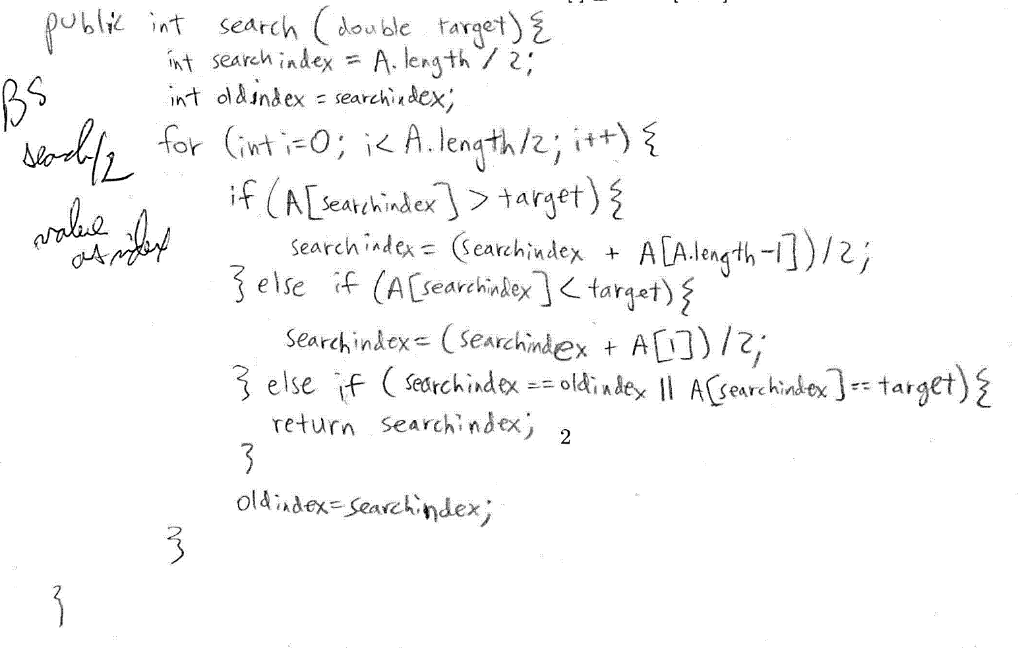
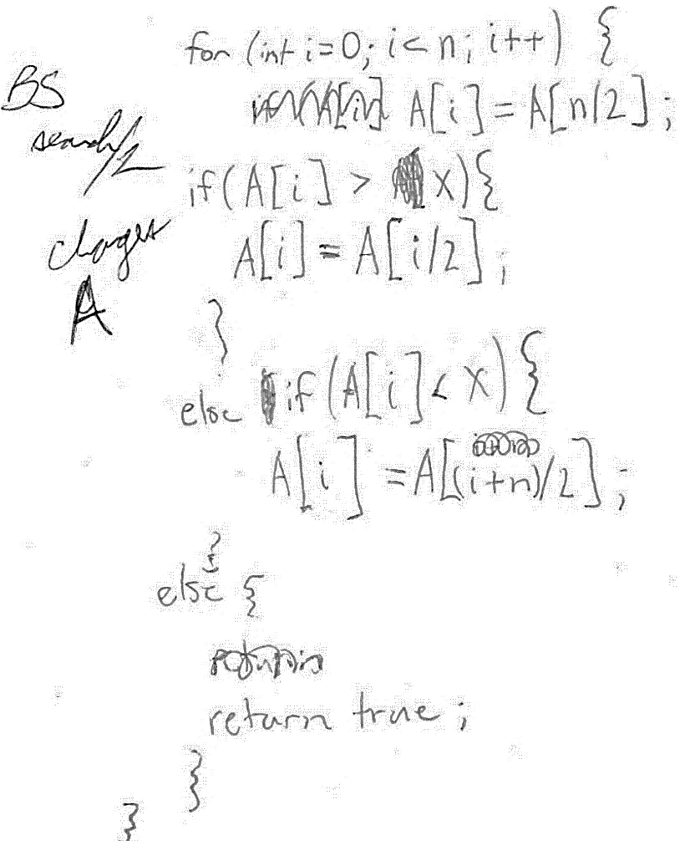
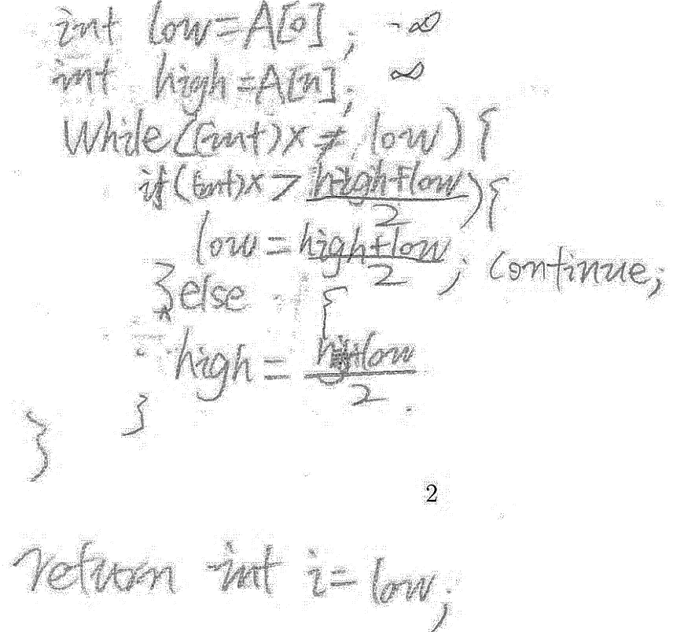
Don’t confuse values & indices!
Values in index calculation!
Doesn’t maintain an interval.
Returns first found; not what was asked for.
Assigns reals as int!
Changes A!
Returns true
Linear “for” loop
Needs interval

Slide 21
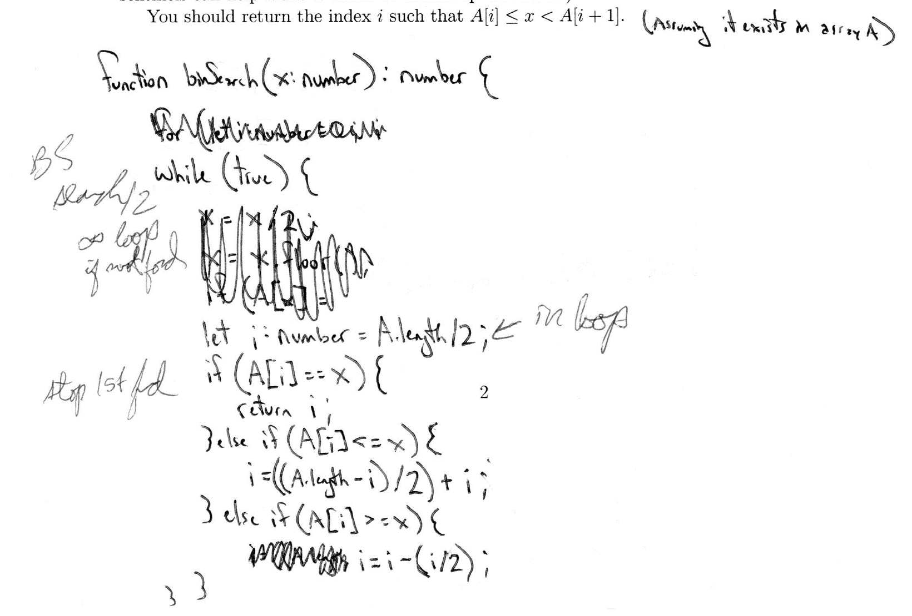
Don’t initialize inside the loop
Initialization inside loop.
Can stop only if x is found; assumption added.
Stops on 1st find.
Needs concept of interval; tries to use a single pointer.

Slide 22
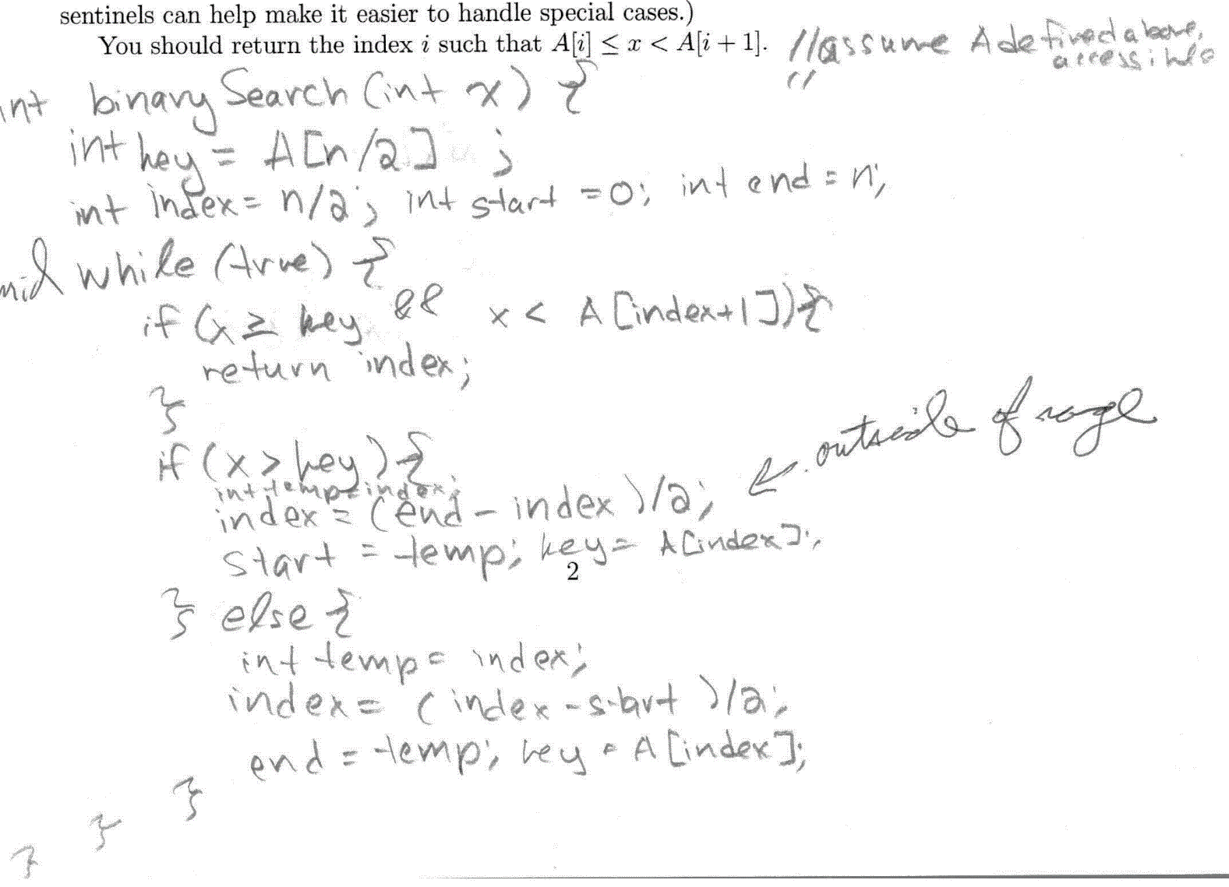
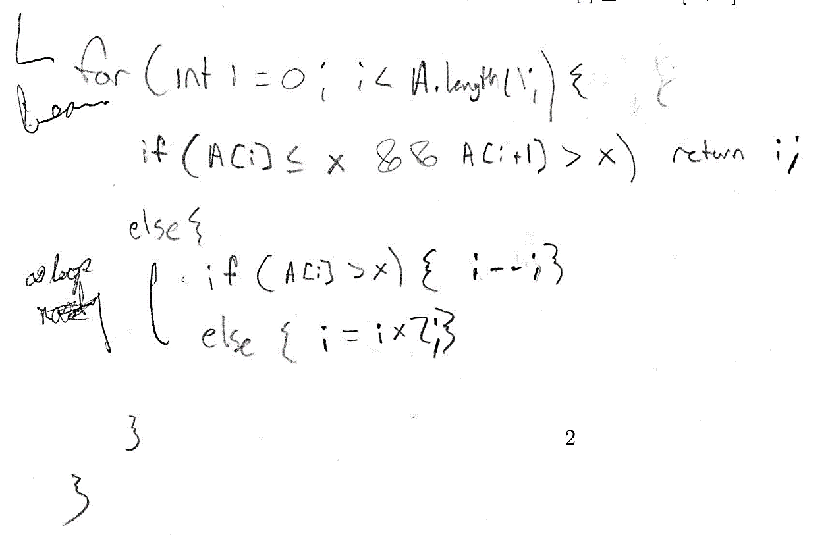
Stay within range bounds!
Doubling can go outside [0,n] interval. (This doubles to find range then performs a linear search backward.)
Subtraction can go outside [start,end] interval. (Unnecessary temp & extra comparisons, BTW)

Slide 23
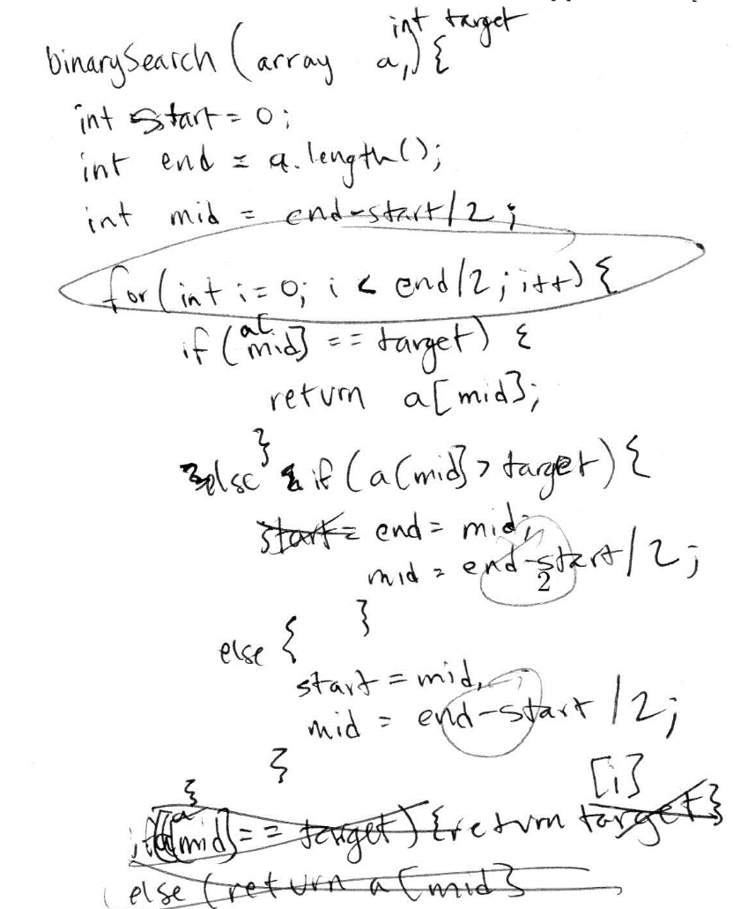
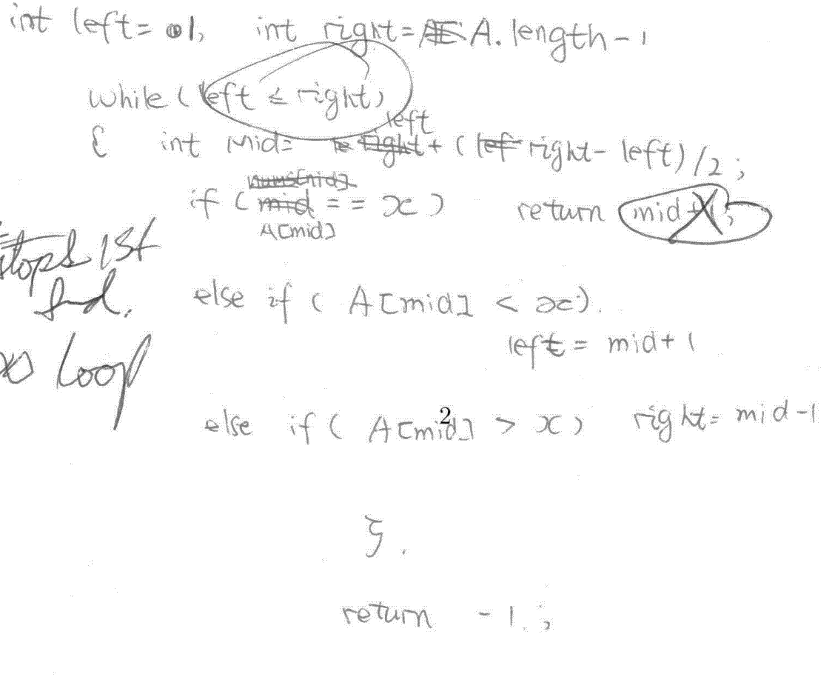
Don’t return things not in the specification
May return index too high or too low when x is found.
-1 is not a valid return value.
Returns value, not index. No return if x not found.
mid not in [start,end].

Slide 24
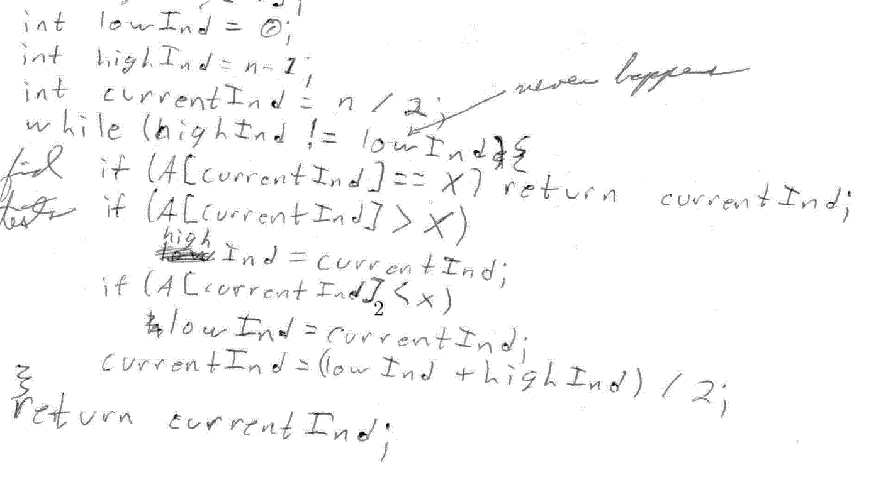
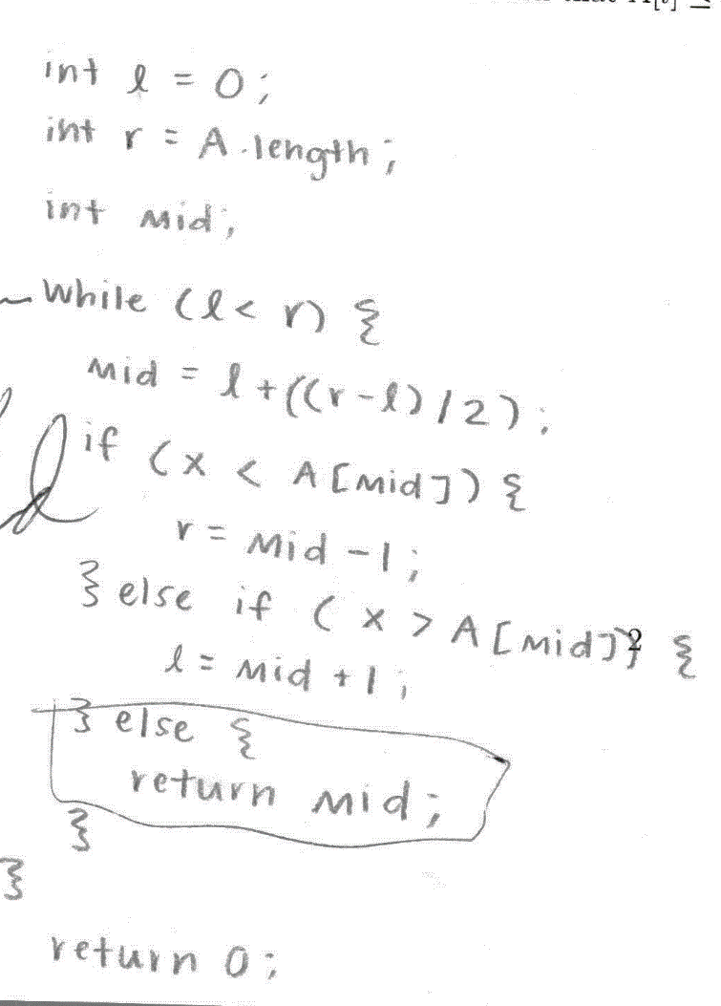
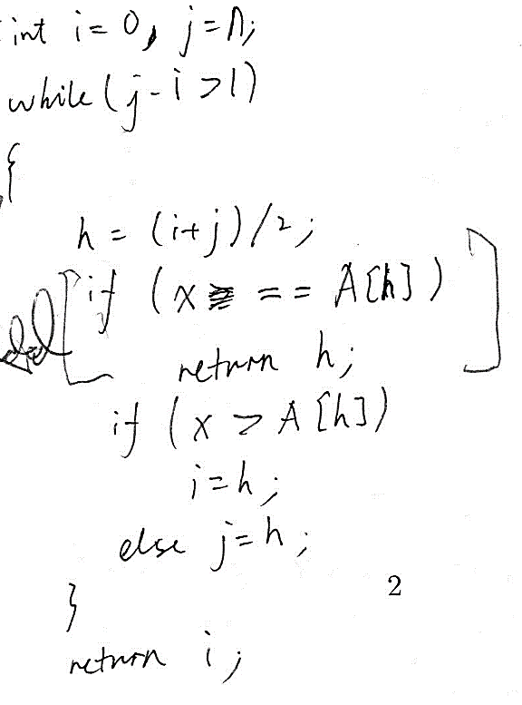
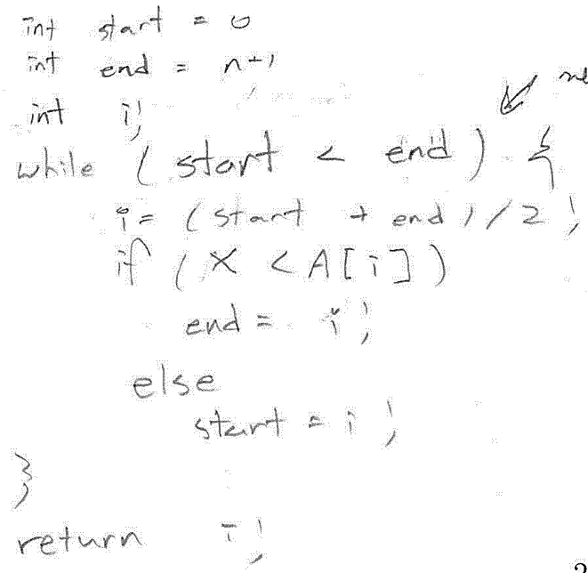
Be sure to terminate, but not too early.
Stops 1st find, but shouldn’t; infinite loop if x is not there.
start < end always; infinite loop
Stop 1st find. Correct if = handled as >.
Stops 1st find, but shouldn’t; Returns 0 if x is not there.

Slide 25
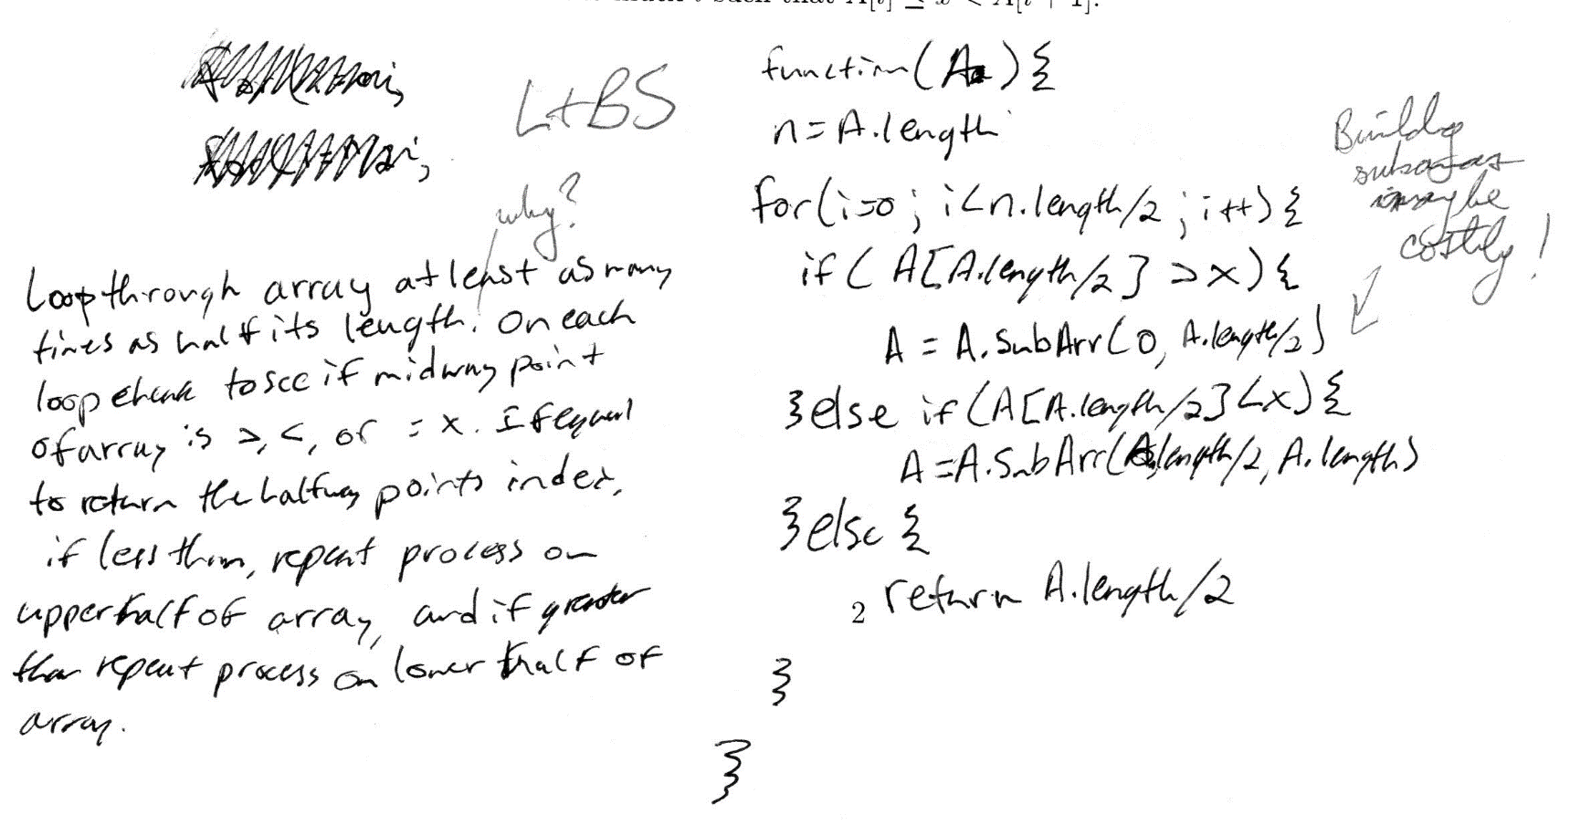
Be aware of memory movement
No return value if x not found.
Returns 1st find.
Can’t get log₂ n if you copy a linear amount of memory!

Slide 26
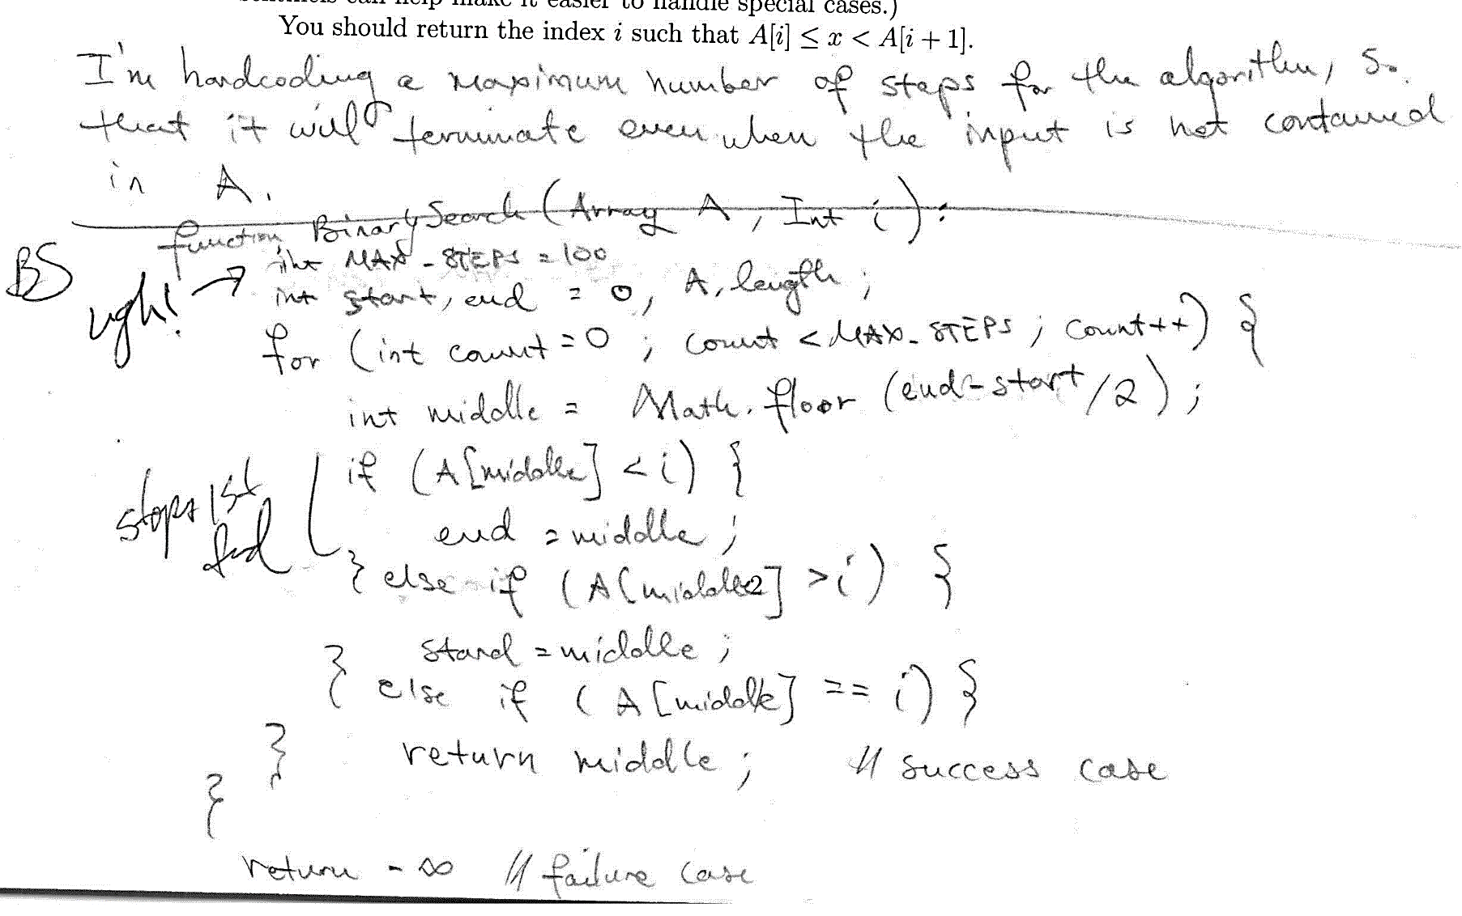
Hardcoded “magic numbers” are evil.
“Success case” stops on 1st find; may be incorrect.

Slide 27
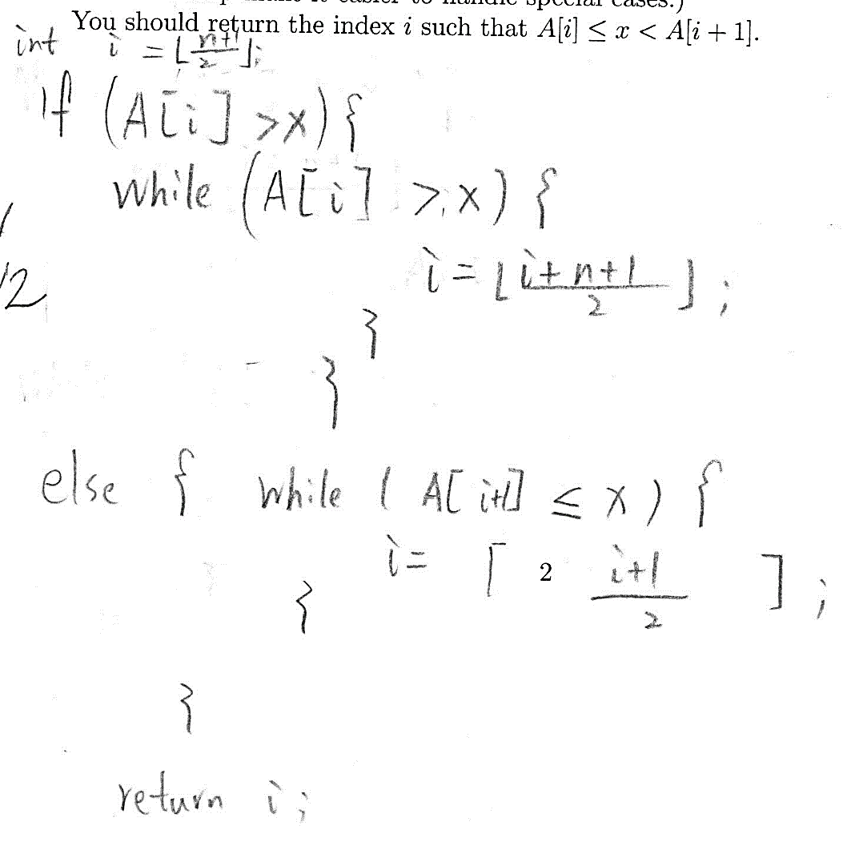
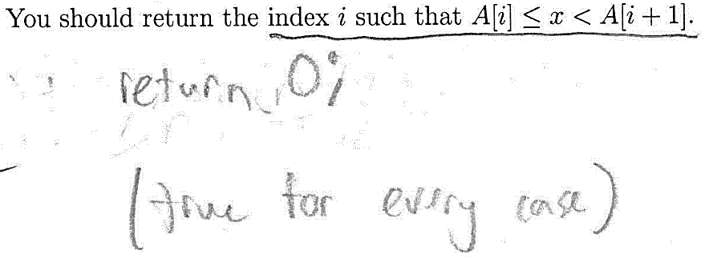
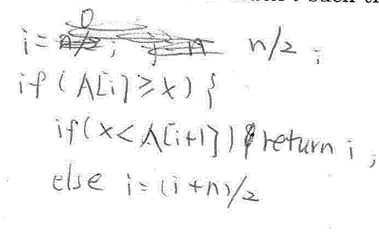
No loop or deciding outside the loop
Here i always increases, but x < A[i]. An infinite loop.
Here i always decreases and gets stuck at 1.

Slide 28
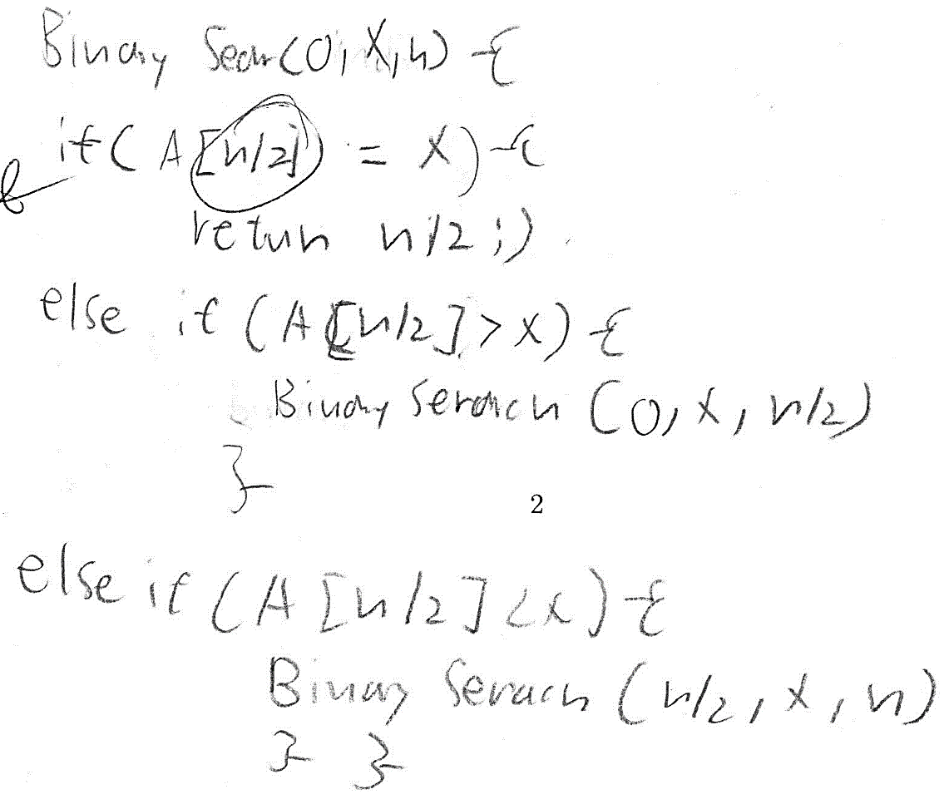
Recursive search
Returns only if found.
Returns 1st find.
Recursion uses stack.

